Slide 1
WEB 서비스
보라매NOC

Slide 2
목차
HTTPD 설치
MARIA DB 설치
PIP 모듈설치
쿼리결과 확인

Slide 3
용어
CGI (common gateway interface)
CGI는 웹서와 프로그램간의 전통적인 인터페이스 제공
WSGI (webserver gateway interface)
웹 서버와 응용 프로그램 간의 규약(specification)으로 서버와 응용 측면에서 각각의 인터페이스
mod_python, FastCGI, mod_wsgi를 포함하는 상위 개념
FCGI
CGI의 성능 문제를 웹서버에 인터프리터를 내장하는 것이 아닌 다른 방식으로 풀어 보려는 시도로 인터프리터를 웹서버에 내장하는 것이 아니라 대몬 형태로 가동시켜두고 웹서버에 내장한 인터페이스 모듈을 통해서 상호 통신하는 방식
mod_python
파이썬 인터프리터를 아파치 웹서버에 내장시켜 인터프리터 로딩에 따른 시간을 낭비를 줄이고 웹서버와의 인터페이스가 좀더 용이하도록 기능을 제공한 것
mod_wsgi
게이트웨이 없애고 웹서버에 직접 WSGI 응용을 내장하는 방식으로 파이썬 wrapper가 불필요함
직접 내장하는 방식과 FastCGI 처럼 대몬 형태로 동작하는 두가지 모드로 사용할 수 있다
Notes:
BEAM : Bogdan/Björn's Erlang Abstract Machine

Slide 4
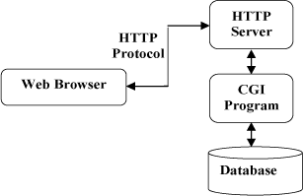
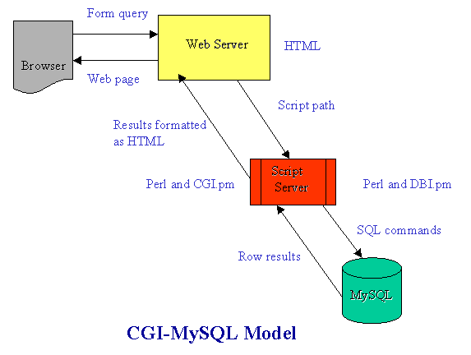
구조
HTTPD+ CGI(PYTHON,PERL)+ MARIADB
CGI (Common Gateway Interface)는 웹서버가 보통 CGI 프로그램 혹은 CGI 스크립트라고 부르는, (웹페이지 내용을 만드는) 외부 프로그램과 통신하는 방법을 정의한다. 웹사이트에서 동적인 페이지를 만드는 가장 흔하고 간단한 방법이다
Notes:
BEAM : Bogdan/Björn's Erlang Abstract Machine

Slide 5
구조
PIP란
파이썬으로 작성된 패키지(라이브러리)관리 프로그램
라이브러리가 의존성과 버전 관리를 자동으로 해줌
파이썬 3 버전을 사용하는 사용자는 pip이 이미 설치되어 있기 때문에 pip을 따로 설치할 필요가 없다. (파이썬 2.7 버전 사용자는 pip이 자동으로 설치가 되지 않기 때문에 수동으로 pip을 설치해 주어야 한다.)
pip 사용법
pip search 패키지 : 패키지 검색
pip install 패키지 : 패키지 설치
pip uninstall 패키지 :패키지 삭제
pip install –upgrade 패키지 : 패키지 업데이트
pip show 패키지 : 설치된 패키지 확인
pip list : 설치된 패키지 리스트
※ 설치된 패키지는 /usr/lib64/python2.7/site-packages에 설치됨
Notes:
BEAM : Bogdan/Björn's Erlang Abstract Machine

Slide 6
설치
Apache를 위한 httpd 설치
[root@localhost ~]# yum install httpd
Loaded plugins: fastestmirror
Loading mirror speeds from cached hostfile
* base: ftp.nara.wide.ad.jp
* extras: mirror.navercorp.com
* updates: mirror.navercorp.com
Resolving Dependencies
--> Running transaction check
---> Package httpd.x86_64 0:2.4.6-45.el7.centos.4 will be installed
--> Processing Dependency: httpd-tools = 2.4.6-45.el7.centos.4 for package: httpd-2.4.6-45.el7.centos.4.x86_64
--> Processing Dependency: /etc/mime.types for package: httpd-2.4.6-45.el7.centos.4.x86_64
--> Processing Dependency: libaprutil-1.so.0()(64bit) for package: httpd-2.4.6-45.el7.centos.4.x86_64
--> Processing Dependency: libapr-1.so.0()(64bit) for package: httpd-2.4.6-45.el7.centos.4.x86_64
--> Running transaction check
---> Package apr.x86_64 0:1.4.8-3.el7 will be installed
---> Package apr-util.x86_64 0:1.5.2-6.el7 will be installed
---> Package httpd-tools.x86_64 0:2.4.6-45.el7.centos.4 will be installed
---> Package mailcap.noarch 0:2.1.41-2.el7 will be installed
--> Finished Dependency Resolution
Dependencies Resolved
==========================================================================================================================
Package Arch Version Repository Size
==========================================================================================================================
Installing:
httpd x86_64 2.4.6-45.el7.centos.4 updates 2.7 M
Installing for dependencies:
apr x86_64 1.4.8-3.el7 base 103 k
apr-util x86_64 1.5.2-6.el7 base 92 k
httpd-tools x86_64 2.4.6-45.el7.centos.4 updates 84 k
mailcap noarch 2.1.41-2.el7 base 31 k
Transaction Summary
==========================================================================================================================
Install 1 Package (+4 Dependent packages)
Total download size: 3.0 M
Installed size: 10 M
Notes:
BEAM : Bogdan/Björn's Erlang Abstract Machine

Slide 7
설치
python 모듈설치를 위해 epel 설치
[root@localhost ~]# yum instll epel-release
Loaded plugins: fastestmirror
Loading mirror speeds from cached hostfile
* base: ftp.nara.wide.ad.jp
* extras: mirror.navercorp.com
* updates: mirror.navercorp.com
Package yum-3.4.3-150.el7.centos.noarch already installed and latest version
No package instll available.
Resolving Dependencies
--> Running transaction check
---> Package epel-release.noarch 0:7-9 will be installed
--> Finished Dependency Resolution
Dependencies Resolved
==========================================================================================================================
Package Arch Version Repository Size
==========================================================================================================================
Installing:
epel-release noarch 7-9 extras 14 k
Transaction Summary
==========================================================================================================================
Install 1 Package
Total download size: 14 k
Installed size: 24 k
Notes:
BEAM : Bogdan/Björn's Erlang Abstract Machine

Slide 8
설치
mod_wsgi.x86_64 : A WSGI interface for Python web applications in Apache
[root@localhost ~]# yum install mod_wsgi
Loaded plugins: fastestmirror
Loading mirror speeds from cached hostfile
* base: ftp.nara.wide.ad.jp
* epel: mirror.rise.ph
* extras: mirror.fairway.ne.jp
* updates: mirror.fairway.ne.jp
Resolving Dependencies
--> Running transaction check
---> Package mod_wsgi.x86_64 0:3.4-12.el7_0 will be installed
--> Finished Dependency Resolution
Dependencies Resolved
==========================================================================================================================
Package Arch Version Repository Size
==========================================================================================================================
Installing:
mod_wsgi x86_64 3.4-12.el7_0 base 76 k
Transaction Summary
==========================================================================================================================
Install 1 Package
Total download size: 76 k
Installed size: 197 k
Notes:
BEAM : Bogdan/Björn's Erlang Abstract Machine

Slide 9
설치
/var/www/cgi-bin에 index.py 파일생성 및 실행권한 부여
[root@localhost cgi-bin]# vi index.py
#!/usr/bin/env python
# -*- coding:utf-8 -*-
import cgi
import cgitb
import webbrowser
cgitb.enable()
form = cgi.FieldStorage()
if __name__=="__main__":
html_head = """
<html>
<head>
<title>HELLO WORLD</title>
</head>
"""
html_body = """
<body>
<b>Hello world~~~~</b><br>
<b>My name is choga88</b><br>
</body>
</html>
"""
html_space =""" <br> """
print "Content-type: text/html; charset=utf-8\n\n"
print html_head
print html_body
chmod +x index.py
Notes:
BEAM : Bogdan/Björn's Erlang Abstract Machine

Slide 10
설치
/etc/httpd/conf/httpd.conf 파일수정 (한줄만 수정, 공백주의)
<IfModule alias_module>
ScriptAlias / "/var/www/cgi-bin/index.py"
</IfModule>
#
# "/var/www/cgi-bin" should be changed to whatever your ScriptAliased
# CGI directory exists, if you have that configured.
#
<Directory "/var/www/cgi-bin">
AllowOverride None
Options None
Require all granted
AddHandler cgi-script .py
</Directory>
Notes:
BEAM : Bogdan/Björn's Erlang Abstract Machine

Slide 11
설치
httpd 데몬재기동
[root@localhost cgi-bin]# systemctl restart httpd
[root@localhost cgi-bin]# systemctl enable httpd
Created symlink from /etc/systemd/system/multi-user.target.wants/httpd.service to /usr/lib/systemd/system/httpd.service.
[root@localhost cgi-bin]# systemctl status httpd
● httpd.service - The Apache HTTP Server
Loaded: loaded (/usr/lib/systemd/system/httpd.service; enabled; vendor preset: disabled)
Active: active (running) since Sun 2017-04-16 21:39:47 EDT; 15s ago
Docs: man:httpd(8)
man:apachectl(8)
Main PID: 6943 (httpd)
Status: "Total requests: 0; Current requests/sec: 0; Current traffic: 0 B/sec"
CGroup: /system.slice/httpd.service
├─6943 /usr/sbin/httpd -DFOREGROUND
├─6944 /usr/sbin/httpd -DFOREGROUND
├─6945 /usr/sbin/httpd -DFOREGROUND
├─6946 /usr/sbin/httpd -DFOREGROUND
├─6947 /usr/sbin/httpd -DFOREGROUND
└─6948 /usr/sbin/httpd -DFOREGROUND
Apr 16 21:39:47 localhost.localdomain systemd[1]: Starting The Apache HTTP Server...
Apr 16 21:39:47 localhost.localdomain httpd[6943]: AH00558: httpd: Could not reliably determine the server's fully...ssage
Apr 16 21:39:47 localhost.localdomain systemd[1]: Started The Apache HTTP Server.
Hint: Some lines were ellipsized, use -l to show in full.
Notes:
BEAM : Bogdan/Björn's Erlang Abstract Machine

Slide 12
설치
http://서버IP/index.py로 웹접속 확인
[root@localhost cgi-bin]# curl http://localhost/cgi-bin/index.py
<html>
<head>
<title>HELLO WORLD</title>
</head>
<body>
<b>Hello world</b>
</body>
</html>
※ 접속안될시 방화벽 확인
[root@localhost cgi-bin]# systemctl stop firewalld.service
[root@localhost cgi-bin]# systemctl enable firewalld.service
Notes:
BEAM : Bogdan/Björn's Erlang Abstract Machine

Slide 13
설치
mariadb-server , client 설치
[root@localhost cgi-bin]# yum install mariadb-server mariadb
Loaded plugins: fastestmirror
Loading mirror speeds from cached hostfile
* base: mirror.navercorp.com
* epel: ir.mirror.rasanegar.com
* extras: mirror.navercorp.com
* updates: mirror.navercorp.com
Resolving Dependencies
--> Running transaction check
---> Package mariadb-server.x86_64 1:5.5.52-1.el7 will be installed
--> Processing Dependency: mariadb(x86-64) = 1:5.5.52-1.el7 for package: 1:mariadb-server-5.5.52-1.el7.x86_64
--> Processing Dependency: perl-DBI for package: 1:mariadb-server-5.5.52-1.el7.x86_64
--> Processing Dependency: perl-DBD-MySQL for package: 1:mariadb-server-5.5.52-1.el7.x86_64
--> Processing Dependency: perl(vars) for package: 1:mariadb-server-5.5.52-1.el7.x86_64
--> Processing Dependency: perl(strict) for package: 1:mariadb-server-5.5.52-1.el7.x86_64
--> Processing Dependency: perl(Sys::Hostname) for package: 1:mariadb-server-5.5.52-1.el7.x86_64
--> Processing Dependency: perl(POSIX) for package: 1:mariadb-server-5.5.52-1.el7.x86_64
--> Processing Dependency: perl(Getopt::Long) for package: 1:mariadb-server-5.5.52-1.el7.x86_64
--> Processing Dependency: perl(File::Temp) for package: 1:mariadb-server-5.5.52-1.el7.x86_64
--> Processing Dependency: perl(File::Path) for package: 1:mariadb-server-5.5.52-1.el7.x86_64
--> Processing Dependency: perl(File::Copy) for package: 1:mariadb-server-5.5.52-1.el7.x86_64
--> Processing Dependency: perl(File::Basename) for package: 1:mariadb-server-5.5.52-1.el7.x86_64
--> Processing Dependency: perl(Data::Dumper) for package: 1:mariadb-server-5.5.52-1.el7.x86_64
--> Processing Dependency: perl(DBI) for package: 1:mariadb-server-5.5.52-1.el7.x86_64
--> Processing Dependency: /usr/bin/perl for package: 1:mariadb-server-5.5.52-1.el7.x86_64
--> Running transaction check
---> Package mariadb.x86_64 1:5.5.52-1.el7 will be installed
[root@localhost cgi-bin]# systemctl start mariadb
[root@localhost cgi-bin]# systemctl enable mariadb
Notes:
BEAM : Bogdan/Björn's Erlang Abstract Machine

Slide 14
설치
보안스크립트 실행 및 mariadb root passwd 설정
[root@localhost cgi-bin]# mysql_secure_installation
NOTE: RUNNING ALL PARTS OF THIS SCRIPT IS RECOMMENDED FOR ALL MariaDB
SERVERS IN PRODUCTION USE! PLEASE READ EACH STEP CAREFULLY!
In order to log into MariaDB to secure it, we'll need the current
password for the root user. If you've just installed MariaDB, and
you haven't set the root password yet, the password will be blank,
so you should just press enter here.
Enter current password for root (enter for none):
OK, successfully used password, moving on...
Setting the root password ensures that nobody can log into the MariaDB
root user without the proper authorisation.
Set root password? [Y/n] y
New password:
Re-enter new password:
Password updated successfully!
Reloading privilege tables..
... Success!
By default, a MariaDB installation has an anonymous user, allowing anyone
to log into MariaDB without having to have a user account created for
them. This is intended only for testing, and to make the installation
go a bit smoother. You should remove them before moving into a
production environment.
Remove anonymous users? [Y/n] y
... Success!
Normally, root should only be allowed to connect from 'localhost'. This
ensures that someone cannot guess at the root password from the network.
Disallow root login remotely? [Y/n] n
... skipping.
By default, MariaDB comes with a database named 'test' that anyone can
access. This is also intended only for testing, and should be removed
before moving into a production environment.
Remove test database and access to it? [Y/n] y
- Dropping test database...
... Success!
- Removing privileges on test database...
... Success!
Reloading the privilege tables will ensure that all changes made so far
will take effect immediately.
Reload privilege tables now? [Y/n] y
... Success!
Cleaning up...
All done! If you've completed all of the above steps, your MariaDB
installation should now be secure.
Thanks for using MariaDB!
Notes:
BEAM : Bogdan/Björn's Erlang Abstract Machine

Slide 15
설치
mariadb접속 및 database입력 (class.sql 파일복사 필요)
[[root@localhost cgi-bin]# mysql -uroot -p -e"create database class"
Enter password:
[root@localhost cgi-bin]# mysql -uroot -p -e"show databases"
Enter password:
+--------------------+
| Database |
+--------------------+
| information_schema |
| class |
| mysql |
| performance_schema |
+--------------------+
[root@localhost cgi-bin]# mysql -uroot -p class < class.sql
Enter password:
name
Tade Row
Gimmy
Marry Toeey
avg(mark)
89.2000
[root@localhost cgi-bin]# mysql -uroot -p -e"select * from class.student"
Enter password:
+----+-------------+-------+------+--------+
| id | name | class | mark | sex |
+----+-------------+-------+------+--------+
| 1 | John Deo | Four | 75 | female |
| 2 | Max Ruin | Three | 85 | male |
| 3 | Arnold | Three | 55 | male |
| 4 | Krish Star | Four | 60 | female |
| 5 | John Mike | Four | 60 | female |
| 6 | Alex John | Four | 55 | male |
| 7 | My John Rob | Fifth | 78 | male |
| 8 | Asruid | Five | 85 | male |
| 9 | Tes Qry | Six | 78 | male |
| 10 | Big John | Four | 55 | female |
| 11 | Ronald | Six | 89 | female |
| 12 | Recky | Six | 94 | female |
| 13 | Kty | Seven | 88 | female |
| 14 | Bigy | Seven | 88 | female |
| 15 | Tade Row | Four | 88 | male |
| 16 | Gimmy | Four | 88 | male |
| 17 | Tumyu | Six | 54 | male |
| 18 | Honny | Five | 75 | male |
| 19 | Tinny | Nine | 18 | male |
| 20 | Jackly | Nine | 65 | female |
| 21 | Babby John | Four | 69 | female |
| 22 | Reggid | Seven | 55 | female |
| 23 | Herod | Eight | 79 | male |
| 24 | Tiddy Now | Seven | 78 | male |
| 25 | Giff Tow | Seven | 88 | male |
| 26 | Crelea | Seven | 79 | male |
| 27 | Big Nose | Three | 81 | female |
| 28 | Rojj Base | Seven | 86 | female |
| 29 | Tess Played | Seven | 55 | male |
| 30 | Reppy Red | Six | 79 | female |
| 31 | Marry Toeey | Four | 88 | male |
| 32 | Binn Rott | Seven | 90 | female |
| 33 | Kenn Rein | Six | 96 | female |
| 34 | Gain Toe | Seven | 69 | male |
| 35 | Rows Noump | Six | 88 | female |
+----+-------------+-------+------+--------+
Notes:
BEAM : Bogdan/Björn's Erlang Abstract Machine

Slide 16
설치- 장표추가
파이썬 pip rpm 설치를 위해 repo 추가
root@localhost cgi-bin]# yum-config-manager --add-repo=http://class.example.com/cloud
root@localhost cgi-bin]# cd /etc/yum.repos.d/
[root@webserver39 yum.repos.d]# cat class.example.com_cloud.repo
[class.example.com_cloud]
name=added from: http://class.example.com/cloud
baseurl=http://class.example.com/cloud
enabled=1
gpgcheck=0
Notes:
BEAM : Bogdan/Björn's Erlang Abstract Machine

Slide 17
설치
파이썬 MySQL 모듈을 import하기위해 pip부터 설치
[root@localhost cgi-bin]# yum install python-pip
Loaded plugins: fastestmirror
Loading mirror speeds from cached hostfile
* base: ftp.nara.wide.ad.jp
* epel: mirror.rise.ph
* extras: mirror.navercorp.com
* updates: mirror.navercorp.com
Resolving Dependencies
--> Running transaction check
---> Package python2-pip.noarch 0:8.1.2-5.el7 will be installed
--> Processing Dependency: python-setuptools for package: python2-pip-8.1.2-5.el7.noarch
--> Running transaction check
---> Package python-setuptools.noarch 0:0.9.8-4.el7 will be installed
--> Processing Dependency: python-backports-ssl_match_hostname for package: python-setuptools-0.9.8-4.el7.noarch
--> Running transaction check
---> Package python-backports-ssl_match_hostname.noarch 0:3.4.0.2-4.el7 will be installed
--> Processing Dependency: python-backports for package: python-backports-ssl_match_hostname-3.4.0.2-4.el7.noarch
--> Running transaction check
---> Package python-backports.x86_64 0:1.0-8.el7 will be installed
--> Finished Dependency Resolution
Dependencies Resolved
==========================================================================================================================
Package Arch Version Repository Size
==========================================================================================================================
Installing:
python2-pip noarch 8.1.2-5.el7 epel 1.7 M
Installing for dependencies:
python-backports x86_64 1.0-8.el7 base 5.8 k
python-backports-ssl_match_hostname noarch 3.4.0.2-4.el7 base 12 k
python-setuptools noarch 0.9.8-4.el7 base 396 k
Transaction Summary
==========================================================================================================================
Install 1 Package (+3 Dependent packages)
Total download size: 2.1 M
Installed size: 9.1 M
Notes:
BEAM : Bogdan/Björn's Erlang Abstract Machine

Slide 18
설치
pip를 사용을 위한 OS 추가패키지 설치
[root@localhost cgi-bin]# yum install python-devel mysql-devel MySQL-python
Loaded plugins: fastestmirror
Loading mirror speeds from cached hostfile
* base: ftp.nara.wide.ad.jp
* epel: mirror.vinahost.vn
* extras: mirror.fairway.ne.jp
* updates: mirror.fairway.ne.jp
Resolving Dependencies
--> Running transaction check
---> Package python-devel.x86_64 0:2.7.5-48.el7 will be installed
--> Finished Dependency Resolution
Dependencies Resolved
==========================================================================================================================
Package Arch Version Repository Size
==========================================================================================================================
Installing:
python-devel x86_64 2.7.5-48.el7 base 393 k
Transaction Summary
==========================================================================================================================
Install 1 Package
Total download size: 393 k
Installed size: 1.0 M
Is this ok [y/d/N]: y
Notes:
BEAM : Bogdan/Björn's Erlang Abstract Machine

Slide 19
설치
pip를 사용하여 MySQL-python 모듈 설치
[root@localhost cgi-bin]# pip install MySQL-python
Collecting MySQL-python
Using cached MySQL-python-1.2.5.zip
Installing collected packages: MySQL-python
Running setup.py install for MySQL-python ... done
Successfully installed MySQL-python-1.2.5
[root@webserver39 yum.repos.d]# pip list | grep python
MySQL-python (1.2.5)
python-augeas (0.5.0)
python-dmidecode (3.10.13)
python-meh (0.25.2)
python-nss (0.16.0)
Notes:
BEAM : Bogdan/Björn's Erlang Abstract Machine

Slide 20
설치
DB 쿼리하는 python code 추가
#!/usr/bin/env python
# -*- coding:utf-8 -*-
import cgi
import cgitb
import webbrowser
import MySQLdb
cgitb.enable()
form = cgi.FieldStorage()
if __name__=="__main__":
html_head = """
<html>
<head>
<title>HELLO WORLD</title>
</head>
"""
html_body = """
<body>
<b>Hello world~~~~</b><br>
<b>My name is choga88</b><br>
</body>
</html>
"""
html_space =""" <br> """
print "Content-type: text/html; charset=utf-8\n\n"
print html_head
print html_body
db = MySQLdb.connect(host="localhost", # your host, usually localhost
user="root", # your username
passwd="cho123", # your password
db="class") # name of the data base
# you must create a Cursor object. It will let
# you execute all the queries you need
cur = db.cursor()
# Use all the SQL you like
cur.execute("select * from student")
# print all the first cell of all the rows
for row in cur.fetchall():
print row[0],"|",row[1],"|",row[2],"|",row[3],"|",row[4]
print html_space
db.close()
Notes:
BEAM : Bogdan/Björn's Erlang Abstract Machine

Slide 21
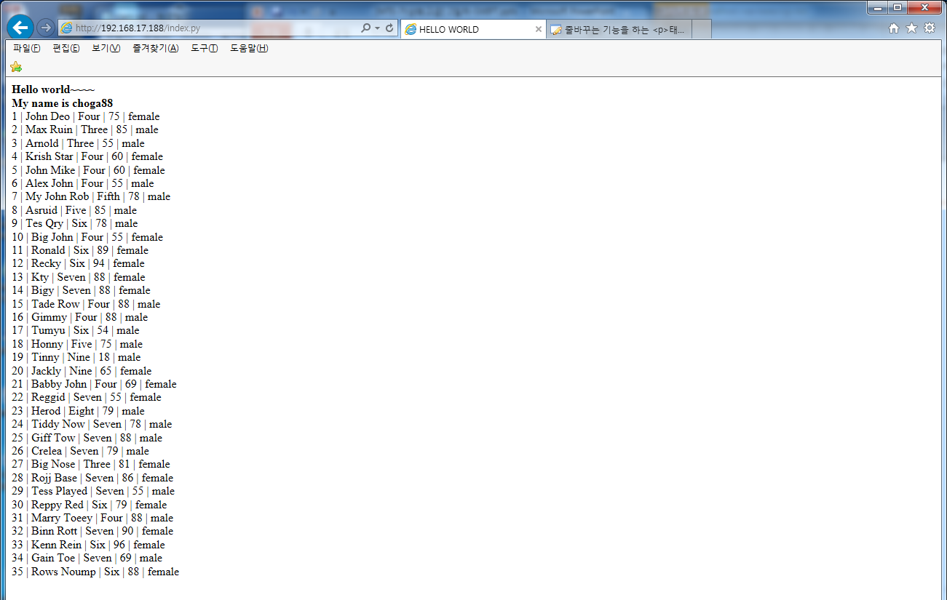
설치
DB쿼리후 결과값 확인
Notes:
BEAM : Bogdan/Björn's Erlang Abstract Machine

Slide 22
설치
DB에 데이타 추가 추가
#!/usr/bin/env python
# -*- coding:utf-8 -*-
import cgi
import cgitb
import webbrowser
import MySQLdb
cgitb.enable()
form = cgi.FieldStorage()
if __name__=="__main__":
html_head = """
<html>
<head>
<title>HELLO WORLD</title>
</head>
"""
html_body = """
<body>
<b>Hello world~~~~</b><br>
<b>My name is choga88</b><br>
</body>
</html>
"""
html_space =""" <br> """
print "Content-type: text/html; charset=utf-8\n\n"
print html_head
print html_body
db = MySQLdb.connect(host="localhost", # your host, usually localhost
user="root", # your username
passwd="cho123", # your password
db="class") # name of the data base
# you must create a Cursor object. It will let
# you execute all the queries you need
cur = db.cursor()
# Use all the SQL you like
cur.execute("insert into student(id,name,class,mark,sex) values(36,'Choga','Three',41,'male')")
cur.execute("select * from student")
# print all the first cell of all the rows
for row in cur.fetchall():
print row[0],"|",row[1],"|",row[2],"|",row[3],"|",row[4]
print html_space
db.close()
Notes:
BEAM : Bogdan/Björn's Erlang Abstract Machine

Slide 23
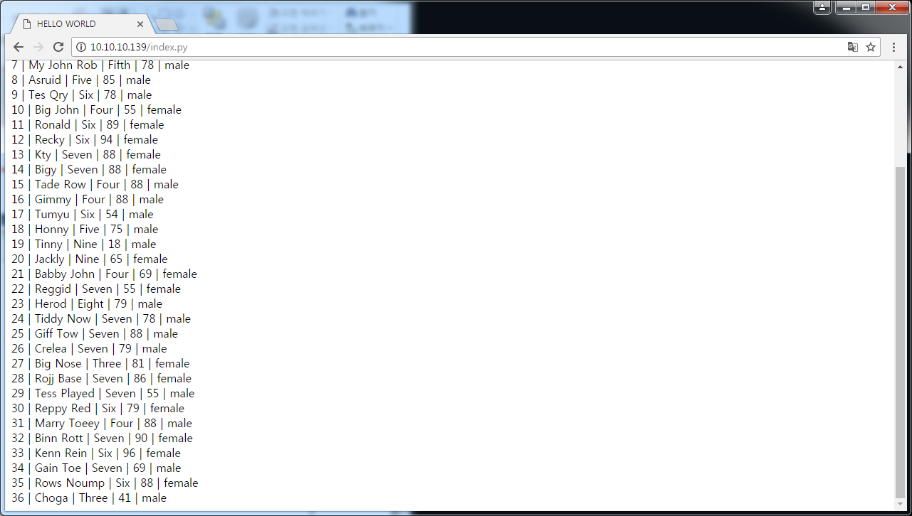
설치
DB쿼리후 추가된 결과값 확인
Notes:
BEAM : Bogdan/Björn's Erlang Abstract Machine

